Slide 1



UNIT 4: So much to do, so little time
What to do

Slide 2
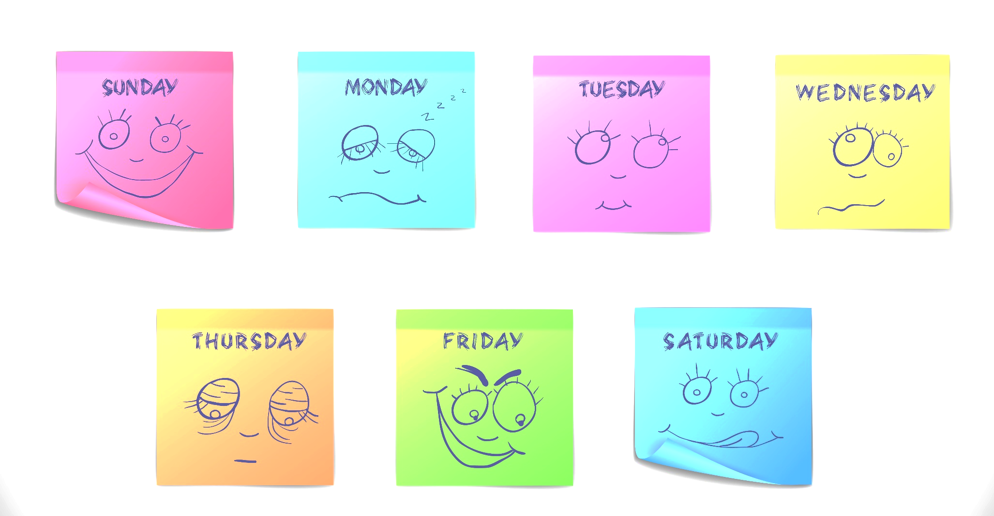
What’s your favourite day of the week?
Why?

Slide 3
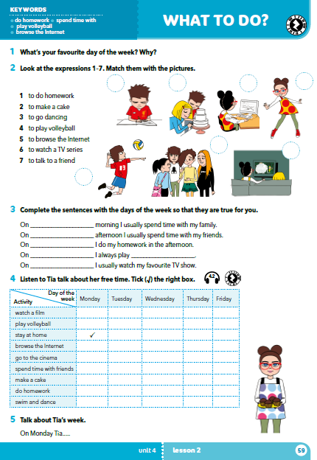
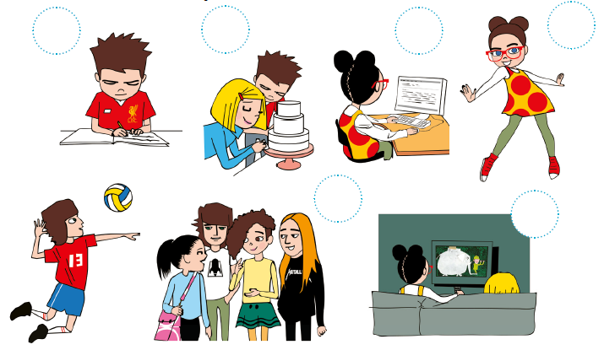
Who can you see?
Where are they?

Slide 4
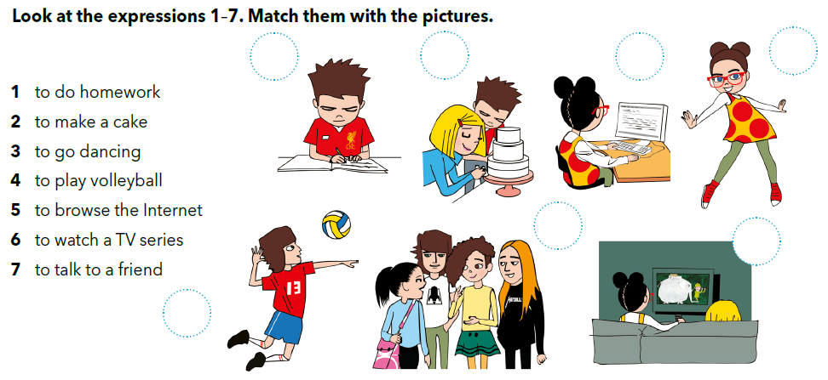
1
2
5
3
7
6
4

Slide 5
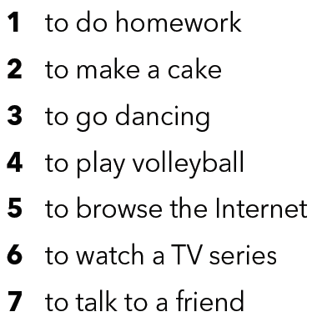
Translate.
pisati zadaću
praviti tortu
plesati; ići na ples
igrati odbojku
pretraživati internet
gledati serije
pričati s prijateljem

Slide 6
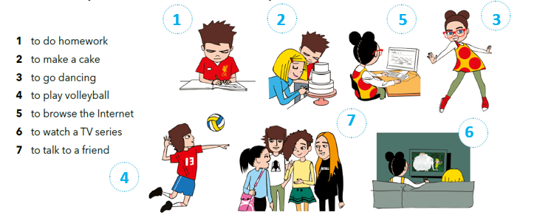
Do you do any of these things in your free time?
When do you do homework / make a cake / go dancing…?

Slide 7
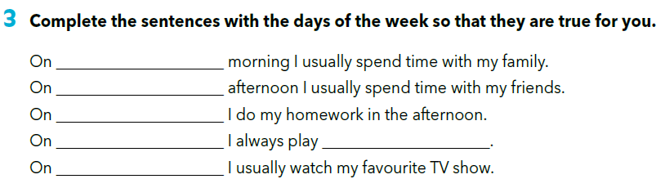
Compare answers with classmates. Say what they do.

Slide 8
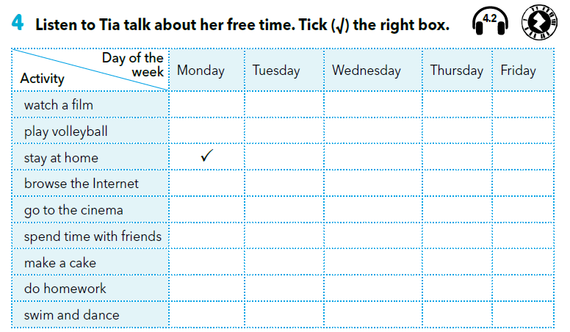


https://www.e-sfera.hr/dodatni-digitalni-sadrzaji/2929d2f4-043f-4dfc-b0bc-39d93cf25f63/assets/audio/31_tia.mp3















Slide 9

What do you think about Tia’s timetable?
Do you have as many activities?
Would you like to have this many activities?
Why? Why not?
Example:
On Monday Tia stays at home and does her homework.

Slide 10
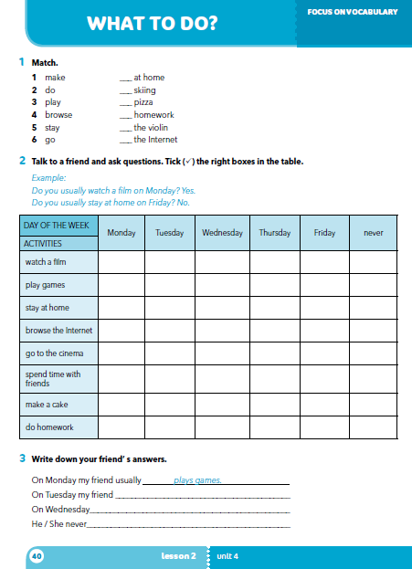
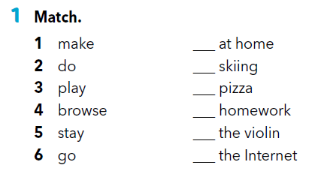
Workbook p 40.
5
6
1
2
3
4

Slide 11
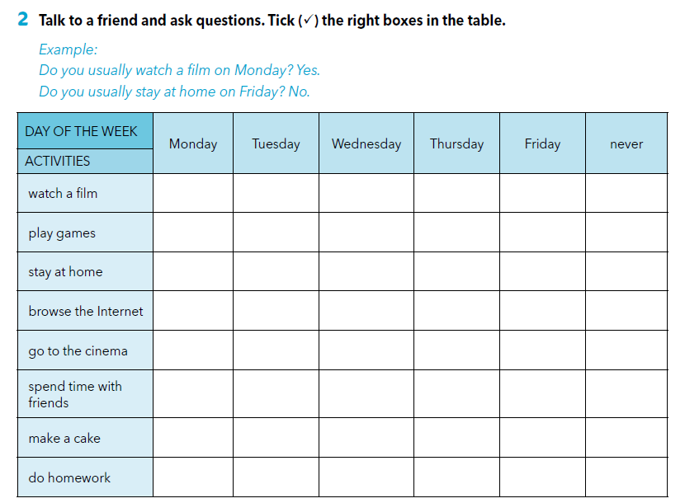

Slide 12
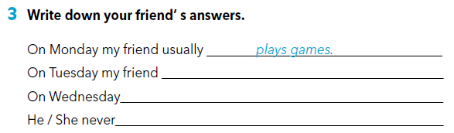
Practise:
https://wordwall.net/resource/256589/what-do

Slide 13

LEARN MORE.
https://www.e-sfera.hr/dodatni-digitalni-sadrzaji/2929d2f4-043f-4dfc-b0bc-39d93cf25f63/
Too many things to do
Read the text and complete the tasks.

